Slide 1
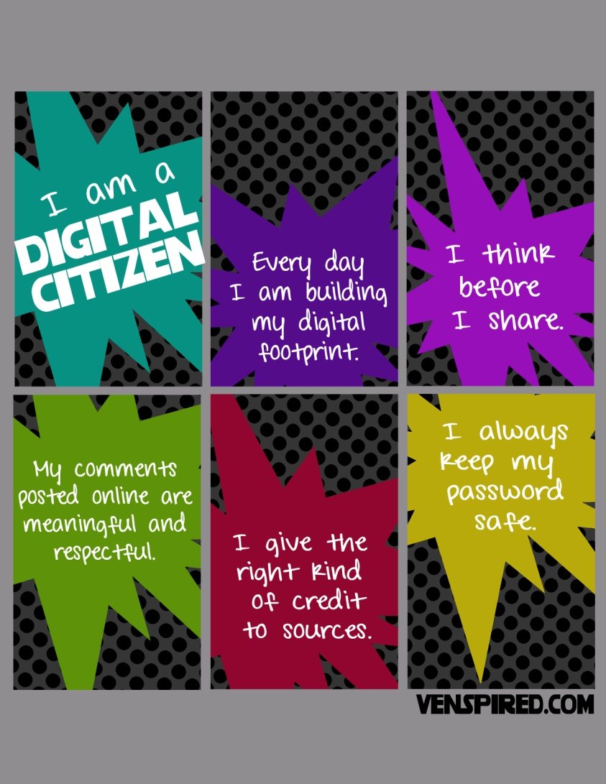
TP – Students will illustrate an example of being a digital citizen by creating an electronic poster/presentation
Positive
Negative

Slide 2
TP – Students will illustrate an example of being a digital citizen by creating an electronic poster/presentation
How can I create a Poster?
Decide what program you would like to use to create your poster?
Microsoft Word
Microsoft Powerpoint
Microsoft Publisher
A drawing program
Are you going to incorporate images? From where?
Will it be a presentation or a poster?
Is your message going to be about positive or negative citizenship?
Think about what you want people to learn from your poster?

Slide 3
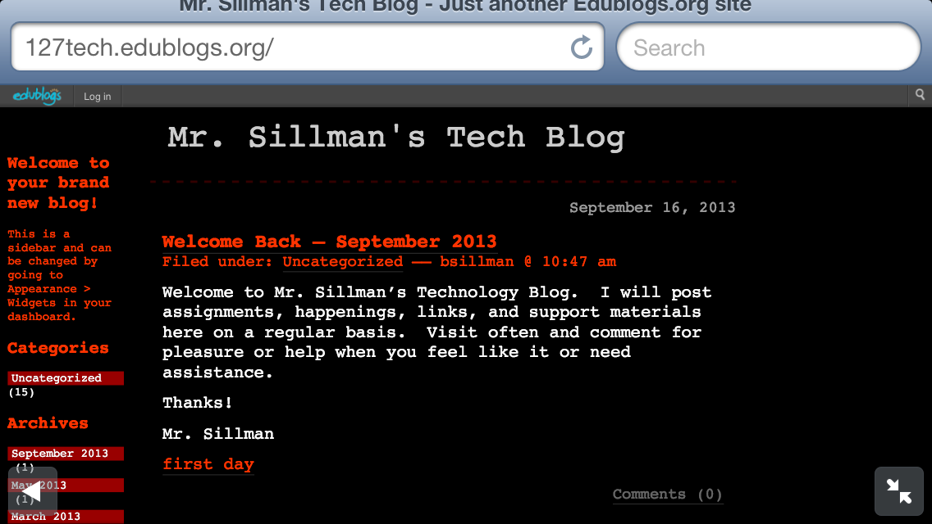
TP – Students will illustrate an example of being a digital citizen by creating an electronic poster/presentation
For help with the project, go to –
www.127tech.edublogs.com
or
email Mr. Sillman at –
mrsillmanteach@gmail.com

