Slide 1
Time line: Dominican Republic’s History
2009
1492
1960
1848
2012
2000
Resources

Slide 2
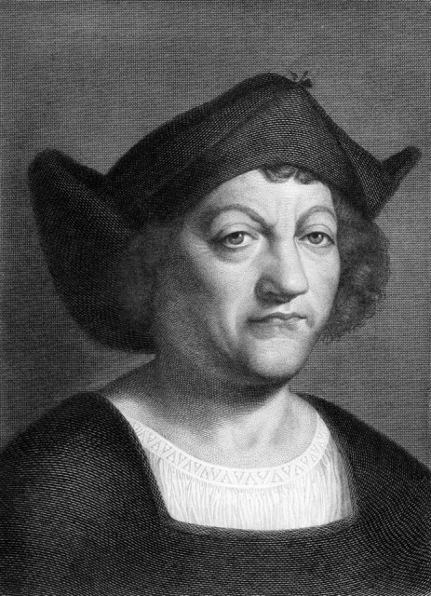
1492
Christopher Columbus actually found Dominican Republic along with Haiti and named it Española, although some people call it Hispañola
http://www.britannica.com/EBchecked/topic/266962/Hispaniola
^^^^For more information click above^^^^

Slide 3
1848
In 1848, the fist president of Dominican Republic was Pedro Santana.
http://www.britannica.com/EBchecked/topic/523129/Pedro-Santana
^^^^For more information click above^^^^

Slide 4
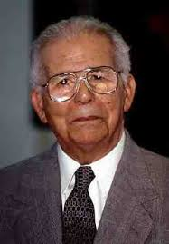
1960-1962
Joaquin Balaguer was elected president, he was the 41 president, and began August 3, and left January 16
http://www.britannica.com/EBchecked/topic/49725/Joaquin-Balaguer
^^^^For more information click above^^^^

Slide 5
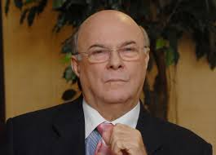
2000
Hipolito Mejia was elected president, he was the 51 president, and he ran for 4 years
http://www.evi.com/q/facts_about__hipolito_mejia
^^^^For more information^^^^ click above

Slide 6
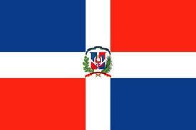
2009
In 2009 Santo Domingo was named the largest capital and city
http://www.godominicanrepublic.com/rd/index.php?option=com_content&view=article&id=9&Itemid=18&lang=en
^^^^For more information ^^^^ click above

Slide 7
2012
Danilo Medina is the 53 president, and also the current one right now.
http://www.britannica.com/EBchecked/topic/1809425/Danilo-Medina
^^^^For more information Click^^^^ above

Slide 8
Resource Page
www.britannica.com
www.evi.com
www.godominicanrepublic.com
www.infoplease.com
News.bbc.co.uk

