Slide 1
TP – Students will design and construct a balloon powered car through research and design
Balloon Car
Critical Thinking
in Engineering Process

Slide 2
TP – Students will design and construct a balloon powered car through research and design
Have you ever blown up a balloon and let it go?
What happens?
Why?

Slide 3
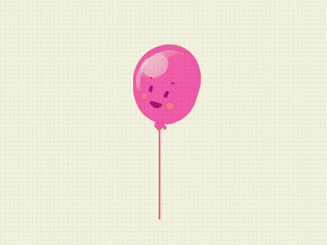
TP – Students will design and construct a balloon powered car through research and design
The air rapidly escapes the balloon making it fly away. Your challenge is to harness this energy to propel a car forward!

Slide 4
TP – Students will design and construct a balloon powered car through research and design
The balloon-powered car has three main parts:
the body
the wheels
the axles
Think about what materials you will use for each part and how they will connect together

Slide 5
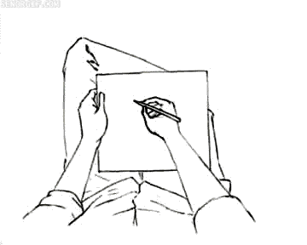
TP – Students will design and construct a balloon powered car through research and design
Now sketch your design and decide what materials you will use for what
Time to bring your design to life! Using your design sketch as a starting point, build your solution. Keep in mind that materials may not work as you predicted. Engineers often have to make several modifications to their original design before they are successful.

Slide 6
TP – Students will design and construct a balloon powered car through research and design
Design Challenge: Make sure you research and decide the type of car you would like to build. Be creative. Make a few sketches of your design before you actually start to build it. That’s what great engineers do!
Engineering Design Constraints:
1. The car must be propelled forward by the air escaping the balloon.
2. The car must be sturdy and not fall apart when in use.
3. The car must travel at least five feet.
4. The car must travel in approximately a straight line.
Materials Suggested:
Power: Latex balloons
Car body: Plastic bottle, plastic cup, cardboard
Wheels: CDs, bottle caps, empty rolls of tape
Axles: Wooden pencils, skewers
Other materials: plastic straws, glue, tape, paper clips, scissors, rubber bands

Slide 7
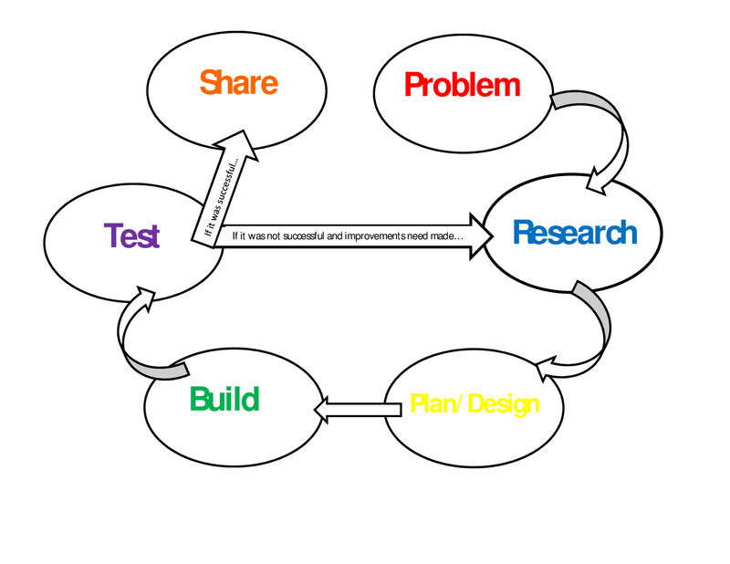
TP – Students will design and construct a balloon powered car through research and design
Engineering Design Process

Slide 8
TP – Students will design and construct a balloon powered car through research and design
What are some questions we should be asking as we test the car?
What are some of the variables that can effect the vehicles?
Did the car meet the goals? (5 ft in approximately a straight line without falling apart)
Does the car move in a straight line, or does it curve to one side? Why?
Does the car move forward smoothly, or is its motion jumpy? Why?
Does the car continue to coast after the balloon is deflated, or does it abruptly come to a stop?
How could you improve the design?

Slide 9
TP – Students will design and construct a balloon powered car through research and design
You will now be asked to get to work on the Technology side of the lesson. You will be asked to take Your pictures/videos and create a presentation. The presentation must include:
The team members names
The initial design – Why did you make that design?
The process – How did you go about the construction?
The problems – What issues did they run into? Did you make changes during the engineering process?
The final car – What were it’s strengths and weaknesses (think about our obseravtions ?
Comments on the other cars – What would you do the same or change?

Slide 10
NATIONAL SCIENCE CONTENT STANDARDS
Unifying Concepts and Processes
Change, constancy, and measurement
Science as Inquiry
Abilities necessary to do scientific inquiry
Physical Science
Position and motion of objects • Motions and forces
Science and Technology
Abilities of technological design
National Mathematics Content Standards
Number and Operations
Geometry
Measurement
Data Analysis and Probability
National Mathematics Process Standards
Problem Solving
Reasoning and Proof
Communication
Connections
Representations

