Slide 1
TP – Students will design and build a bridge through research and design
STEM Challenge #2: Bridges and Bridge Design
Critical Thinking
in Engineering Process

Slide 2
TP – Students will design and build a bridge through research and design
What do you know about bridges?
How are they the same or different?

Slide 3
Introduction to the different types of bridges
TP – Students will design and build a bridge through research and design
beam bridge
suspension bridge
arch bridge

Slide 4
Why are there different types of bridges?
TP – Students will design and build a bridge through research and design
The major difference between the three types of bridges is the distance that they can cover in a single span. Span is the difference between two supports. Each of the different types of bridges holds weight in different ways.

Slide 5
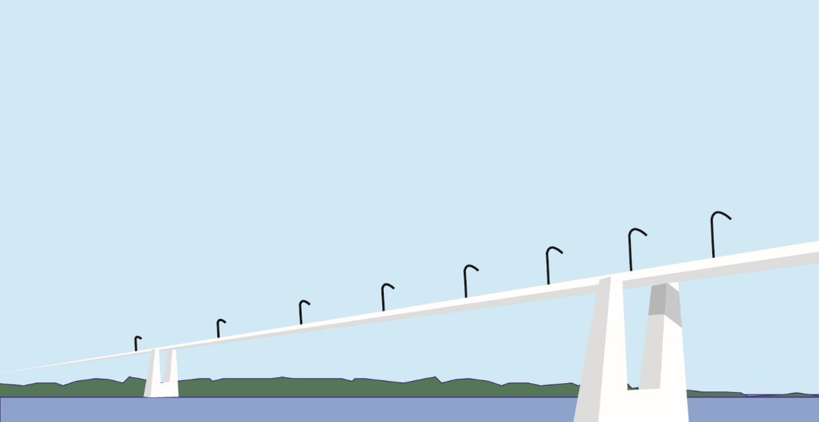
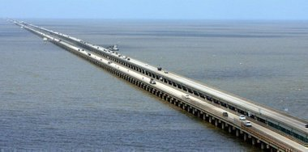
Beam Bridge
TP – Students will design and build a bridge through research and design
A beam bridge is basically a rigid horizontal structure that rest on two supports, one located at each end of the bridge

Slide 6
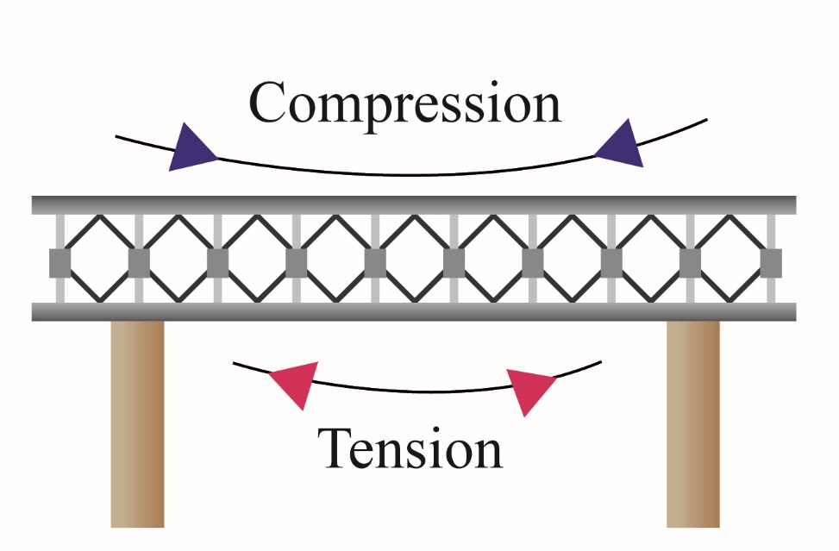
What happens to the bridge when a load is put on the bridge?
TP – Students will design and build a bridge through research and design
When the load pushes down on the beam the top edge is pushed together or compressed, while the bottom of the beam is stretched or is under tension.

Slide 7
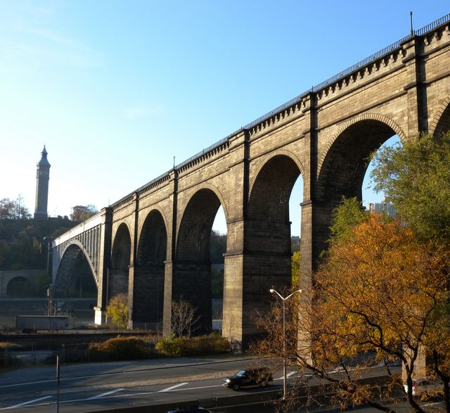
Arch Bridge
TP – Students will design and build a bridge through research and design
An arch bridge is composed of a curved structure with abutments on each end.

Slide 8
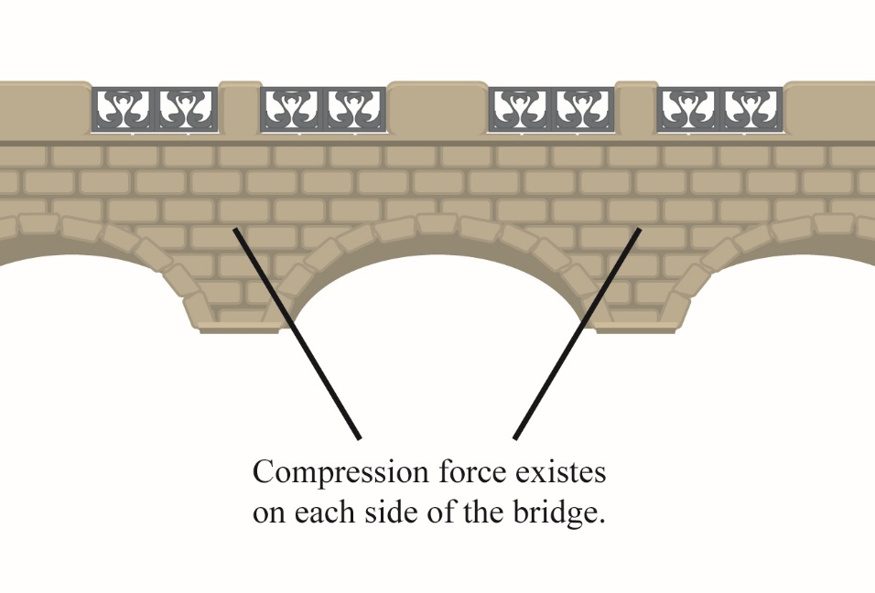
What happens to the bridge when a load is put on the bridge?
TP – Students will design and build a bridge through research and design
The weight of the load is carried outward along the curve of the arch to the abutments at each end of the arch. The abutments also keep the end of the bridge from spreading outward.

Slide 9
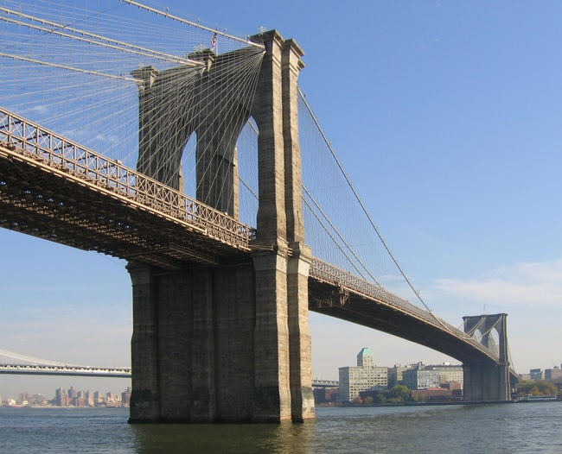
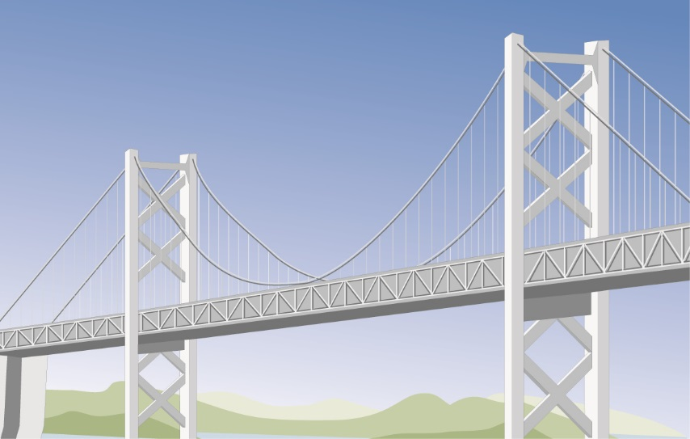
Suspension Bridge
TP – Students will design and build a bridge through research and design
The suspension bridge literally suspends the roadbed from huge cables, which extends from one end of the bridge to the other. The cables are attached to two tall towers and are secured at each end by anchorages.

Slide 10
What happens to the bridge when a load is put on the bridge?
TP – Students will design and build a bridge through research and design
The cable carries the weight on a suspended bridge to the anchorages that are imbedded in solid rock or massive concrete blocks. The cables are spread over a large area in order to evenly distribute the load inside the anchorages to prevent the cables from breaking free.

Slide 11
TP – Students will design and build a bridge through research and design
Design Challenge: Make sure you research what type of bridge you would like to build. Be creative. Make a few sketches of your design before you actually start to build it. That’s what great engineers do!
Criteria: Your Bridge must:
Be at least 12” long
Support 1-­‐2 lbs. (or equivalent metric weight)
Hold the weight for at least 5 minutes
Approximately 3.5 inches tall
A way to get on and off the bridge (toy car…)
Optional: colorful & attractive
Examples of Materials you can use:
Cardboard or cardboard tubes
Paper clips, straws, toothpicks, popsicle sticks
Construction paper, tape, Styrofoam, egg cartons, string
Poster board, food items
Research: Look up the following bridges and decide which one you would like to build:
Beam bridge
Suspension bridge
Arch bridge

Slide 12
TP – Students will design and build a bridge through research and design
Design Challenge: Make sure you research what type of bridge you would like to build. Be creative. Make a few sketches of your design before you actually start to build it. That’s what great engineers do!
What type of bridge will you build? Why?
What is your bridge going to look like?
What materials will it be composed of?
Why will it support the weight placed upon it?
Sketch a few designs and label what materials you will create it with.

Slide 13
TP – Students will design and build a bridge through research and design
Evaluate your Bridge:
What would you have done
differently?___________________________________________________________________
_____________________________________________________________________________
What could you add to it to make it
better?_______________________________________________________________________
_____________________________________________________________________________
What was the easiest part to build/what was the most
difficult?______________________________________________________________________
_____________________________________________________________________________
How does this bridge relate to “real-­‐life”? How would it be used? Where would it be
located?___________________________________________________________________________________________________________________________________________________

