Slide 1
TP – Students will create a tower through teamwork and problem solving
What does S.T.E.M. stand for?

Slide 2
TP – Students will create a tower through teamwork and problem solving
What is an engineer?
What do they do?

Slide 3
TP – Students will create a tower through teamwork and problem solving
DEFINITION
To Plan, Construct, or Manage

Slide 4
TP – Students will create a tower through teamwork and problem solving
When planning a project, what are some of the things an engineer needs to consider?

Slide 5
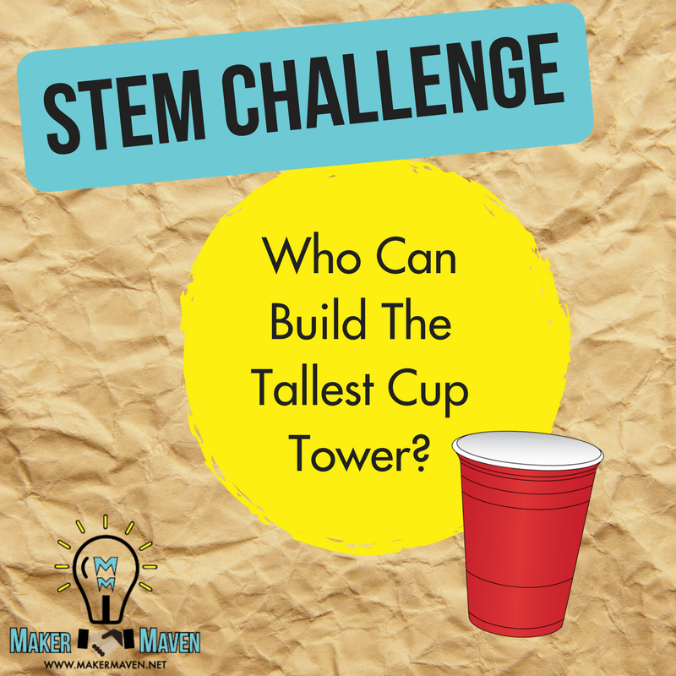
TP – Students will create a tower through teamwork and problem solving

Slide 6
TP – Students will create a tower through teamwork and problem solving
When planning this project, what are some of the things you and your team of “engineers” needs to consider?

Slide 7
TP – Students will create a tower through teamwork and problem solving
Step 1:
Break into groups of 3-5.

Slide 8
TP – Students will create a tower through teamwork and problem solving
Step 2:
You are going to document the entire process with pictures or video. You may use a phone or media device – inform me if you do not have one

Slide 9
TP – Students will create a tower through teamwork and problem solving
Step 3:
You are going to start your planning process – how will it look? Why?
Include notes, drawings, sketches, etc.

Slide 10
TP – Students will create a tower through teamwork and problem solving
Building Time:
You have about 10 Minutes. You must listen to any further instructions I give.

Slide 11
TP – Students will create a tower through teamwork and problem solving
Viewing the Towers:
Look at all the towers - How do they differ?
How are They Alike?
Which one is best? Why?

Slide 12
TP – Students will create a tower through teamwork and problem solving
Project Time:
You will now be asked to get to work on the Technology side of the lesson. You will be asked to take Your pictures/videos and create a presentation. The presentation must include:
The team members names
The initial design – Why did you make that design?
The process – How did you go about the construction?
The problems – What issues did they run into? (include how my changes affected their projects)
The final tower – What were it’s strengths and weaknesses?
Comments on the other towers – What would you do the same or change?

