Slide 1
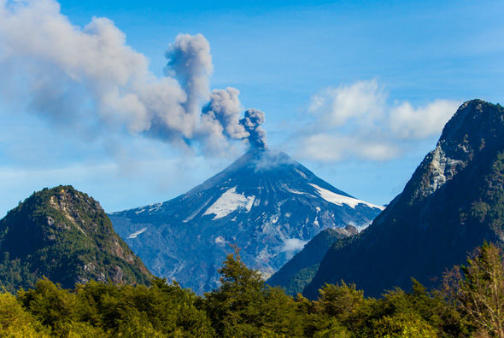
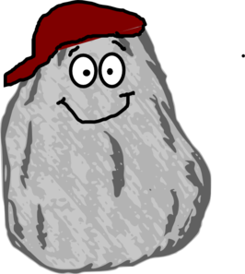
My name is Rocky! I am an igneous rock. I was born from the lava that came from the volcano behind me.

Slide 2
Throughout my life, I have gone through many changes. Let me tell you about them…

Slide 3
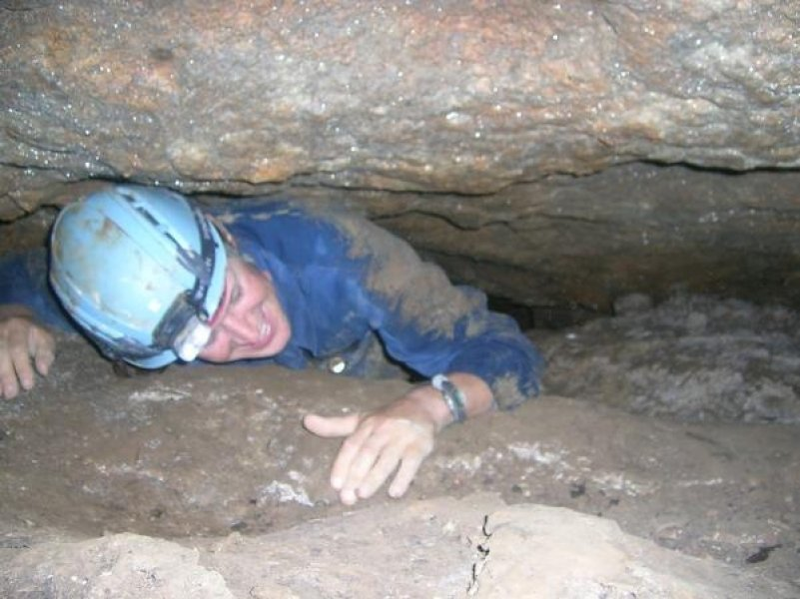
First, I was trapped under pressure for centuries and felt myself changing.

Slide 4
You can say I went through a metamorphosis. After, I got free, you could say I was a metamorphic rock.

Slide 5
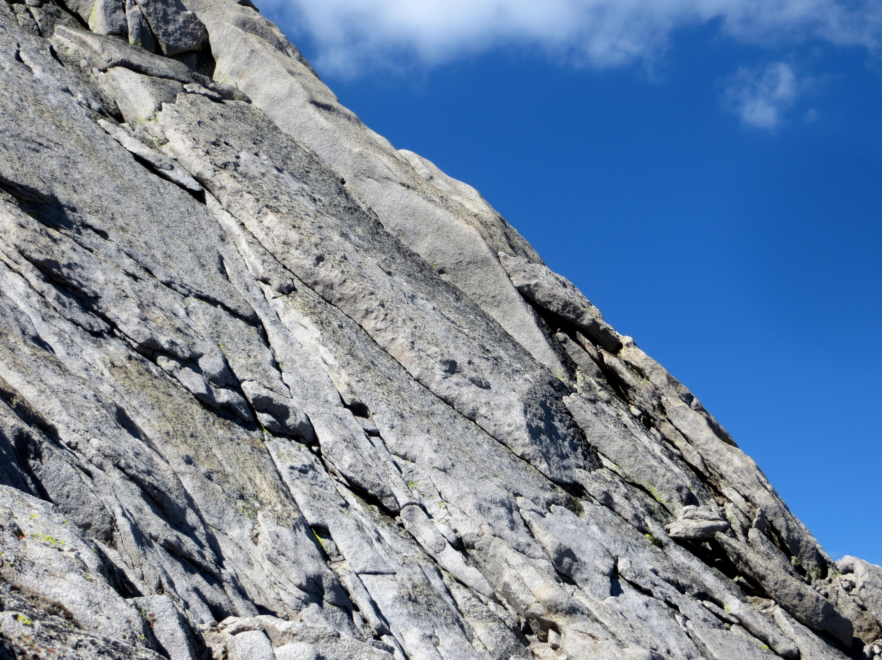
One day, I felt the earth shake, and I went rolling down the hill. I felt myself breaking up.

Slide 6
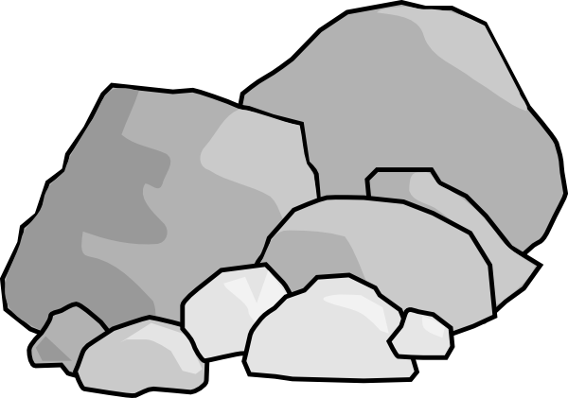
By the time I reached the bottom, I was just rubble. I thought my life was over…

Slide 7
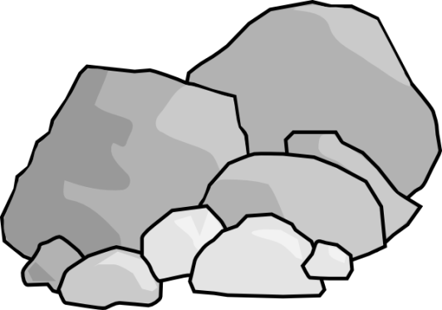
Then one day a strong wind blew in and swept my pieces away.

Slide 8
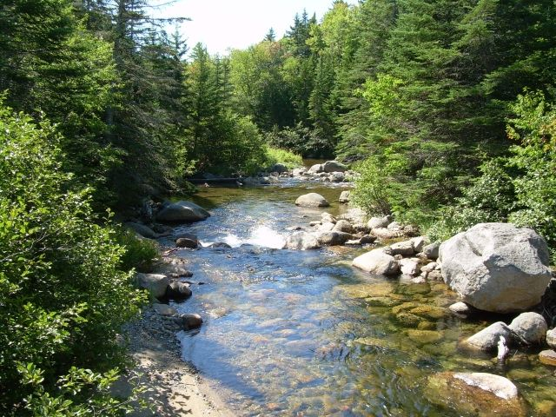
I landed in a stream where my pieces collected. They were pushed together and almost glued by the water

Slide 9
After some time, I felt like myself again. Except now I was a sedimentary rock.

