Slide 1
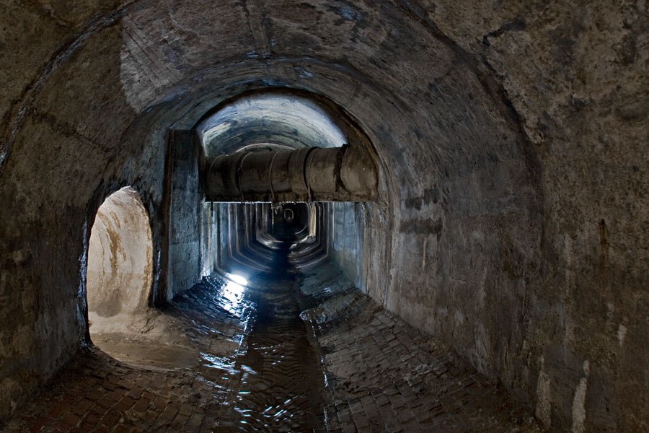
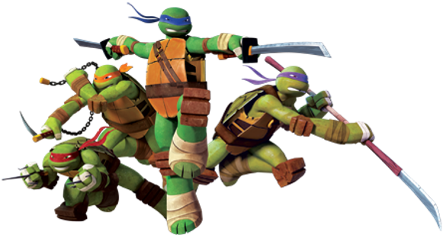
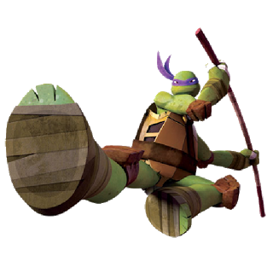
The evil Shredder is going to blow up the building! Let’s get him!
In order to blow it up he needs to calculate the volume so he knows how much TNT to use!
Yeah, but he would have know to multiply the buildings length*width*height to find that out. He’s not that bright!
Can’t we just get some pizza instead!

Slide 2
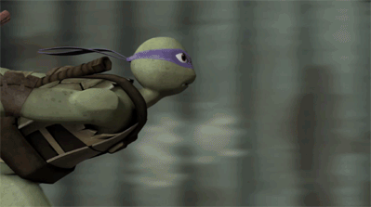
ATTACK The Shredder!!!!!!

Slide 3
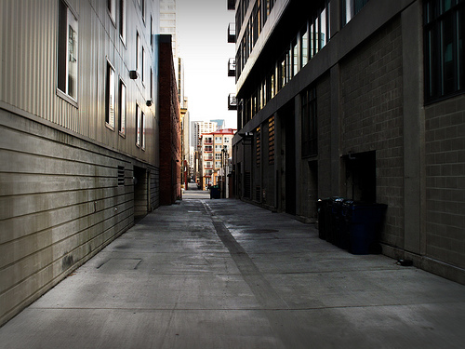
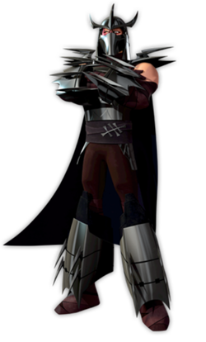
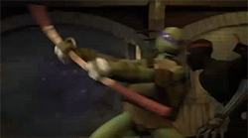
Why has the building not blown up?
You used the wrong amount of explosives, Metalhead! You probably didn’t multiply correctly!
OH NO!
Foot Soldiers!

Slide 4
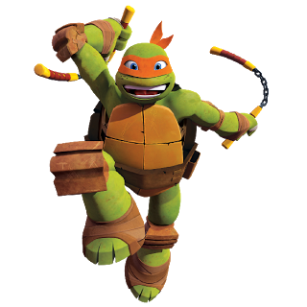
The foot soldiers have surrounded the perimeter!
What’s a perimeter, dude?
C’mon Dude! It’s the boundary surrounding a geometric shape! Duh!
Then let’s get ‘em!

Slide 5
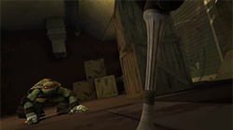
ATTACK !!!!

