Slide 1
COUNT ON ME BY:BY BRUNO MARS
interpreted by Darleny marine

Slide 2
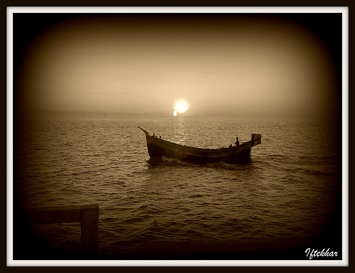
If you ever find yourself stuck in the middle of the sea,
I'll sail the world to find you
If you ever find yourself lost in the dark and you can't see,
I'll be the light to guide you

Slide 3
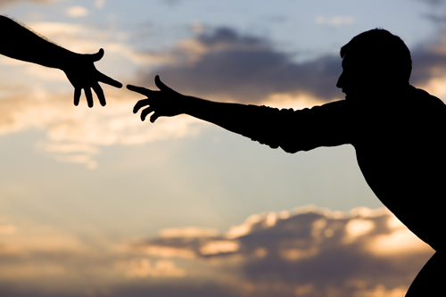
Find out what we're made of
When we are called to help our friends in need

Slide 4
You can count on me like one two three
I'll be there
And I know when I need it I can count on you like four three two
You'll be there
Cause that's what friends are supposed to do, oh yeah

Slide 5
Whoa, whoa
Oh, oh
Yeah, yeah

Slide 6
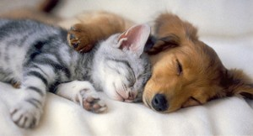
If you tossing and you're turning and you just can't fall asleep
I'll sing a song
Beside you
And if you ever forget how much you really mean to me
Everyday I will
Remind you

Slide 7
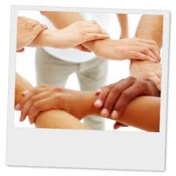
Ooh
Find out what we're made of
When we are called to help our friends in need

Slide 8
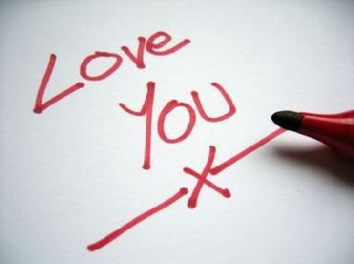
You can count on me like one two three
I'll…

Slide 9
THE END

