Slide 1
By: Zarin Khan

Slide 2
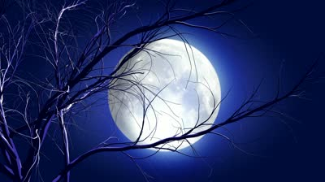
I wish moon was full and bright , like you are cool and right. You will be all right, cause the sun is going down. When I go swathing of the light. I wish you Good Night…..

Slide 3
Is getting dark outside. The stars are coming out, to play…. I wish that, that could happen everyday…. I wish you good night…..

Slide 4
The shadows are coming. the silent is so loud. I never experience before. All the lights are gone in every house. I wish you good night…..
night…..

Slide 5
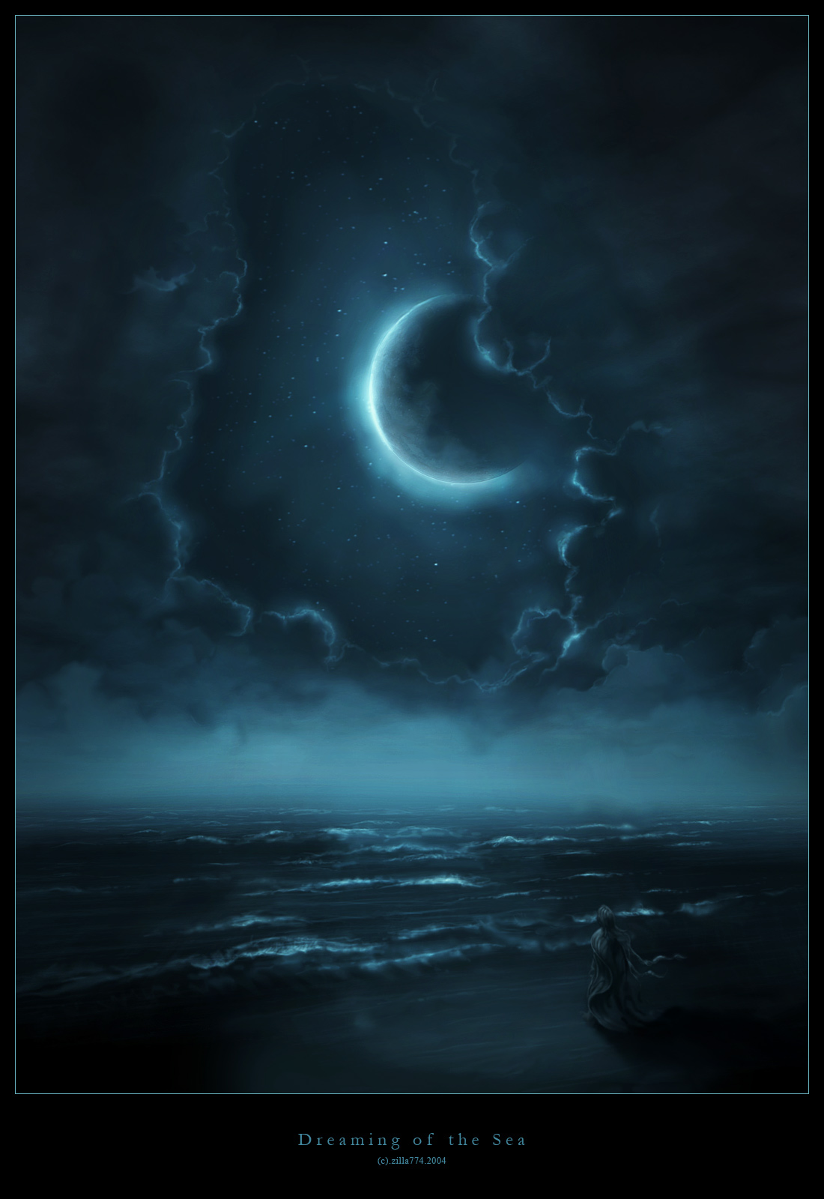
Shades, darkness are coming out…. Dreams are having, freedom…. Every body’s are a sleep. I wish you good night….. Night….. Good night….. Good night….. Good night!

Slide 6
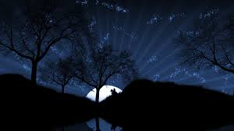
The end

