Slide 1
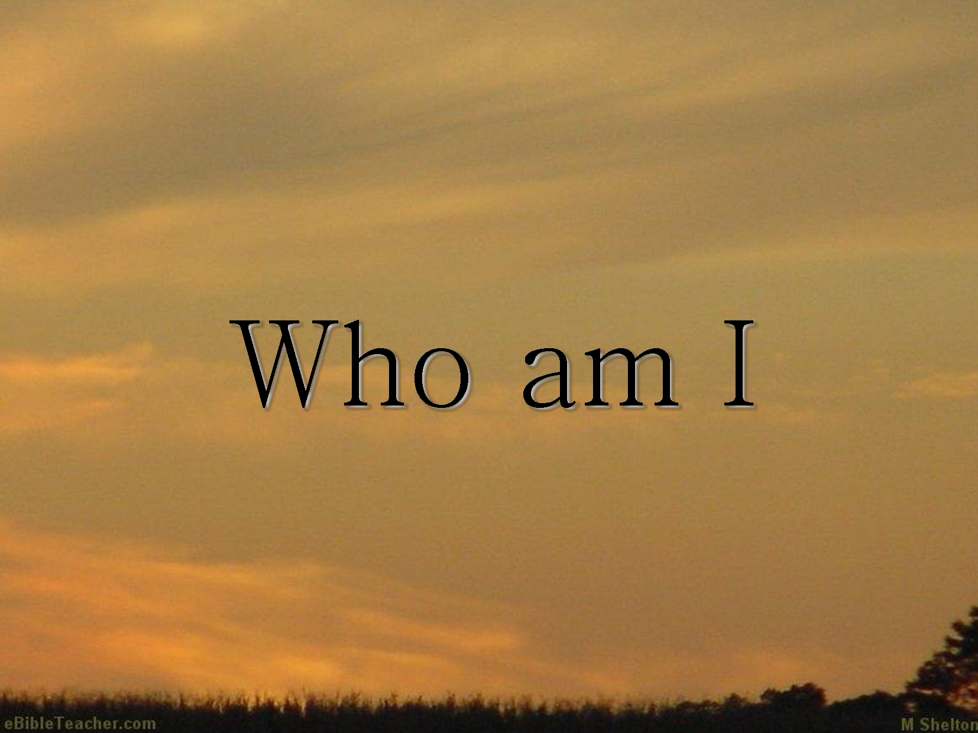
BY: Christie Duverger

Slide 2
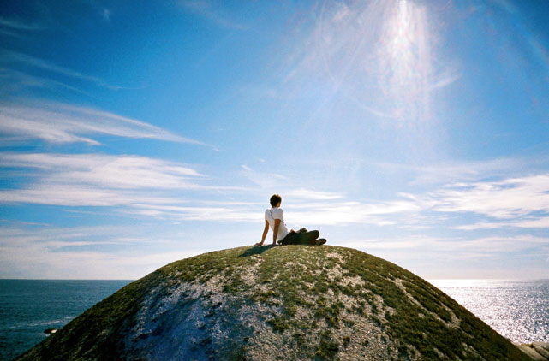
I know I can reach the top of the world.

Slide 3
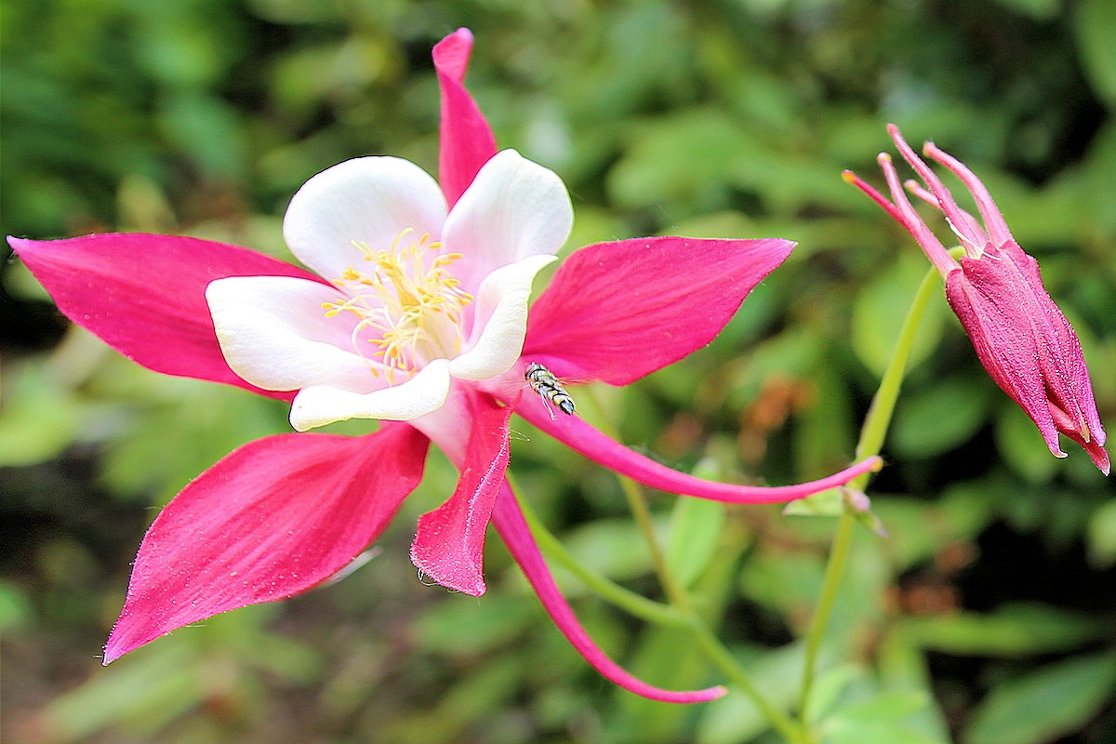
Be all I am it is so beautiful.

Slide 4
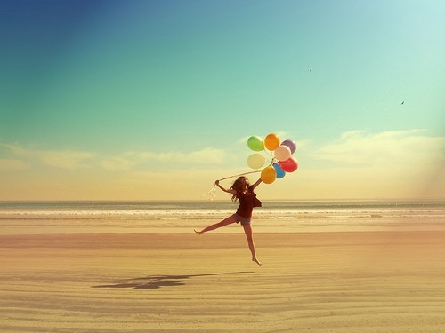
I wanna feel free to be who I am.

Slide 5
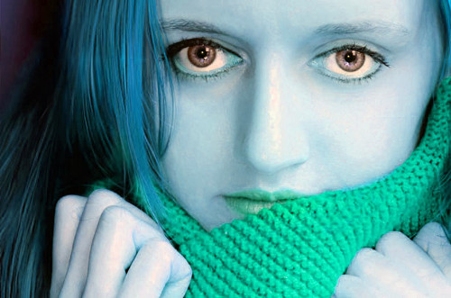
What I am about is more than I’ve been.

Slide 6
I am ready to show the world who I am

Slide 7
There is so much for me.

Slide 8
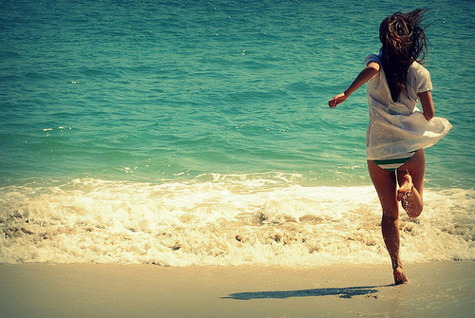
I’m not going to stop cause I believe .

Slide 9
It is who I am.

Slide 10
www.christie.

