Slide 1
Fear No More By William Shakespeare
An Interpretation Mariette Jaramillo 6-407

Slide 2
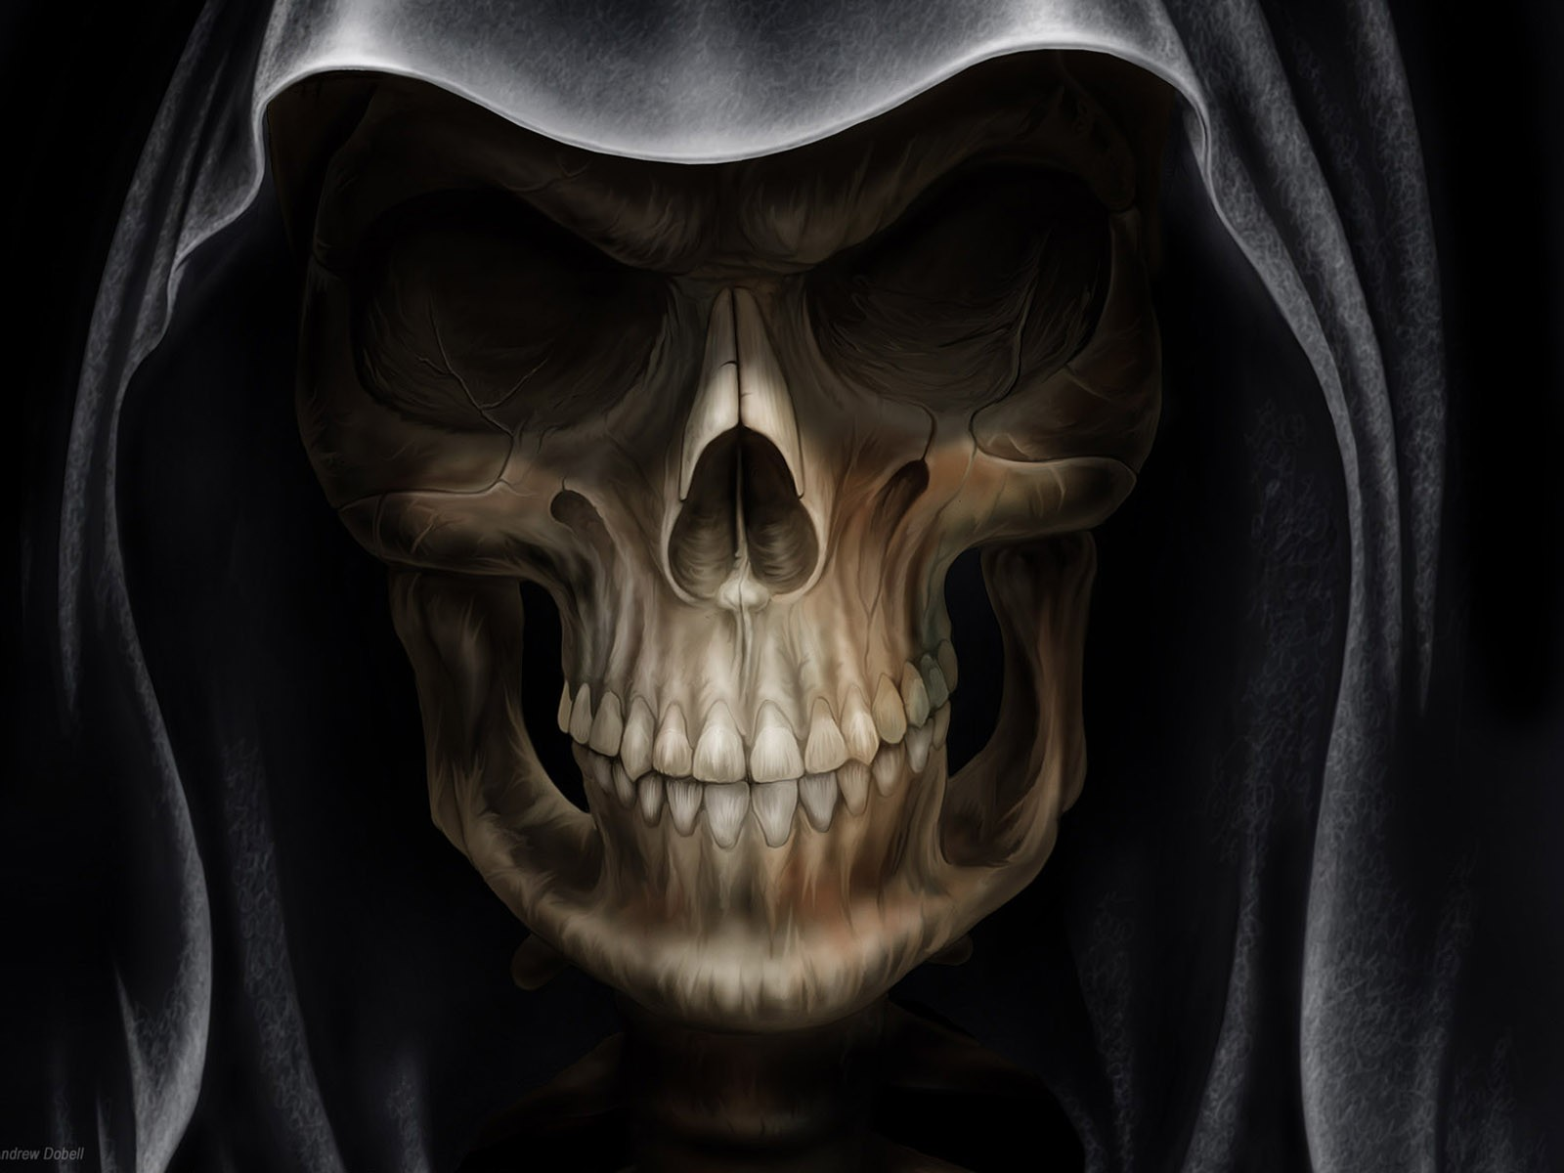
Fear no more the heat o' the sun; Nor the furious winter's rages, Thou thy worldly task hast done, Home art gone, and ta'en thy wages; Golden lads and girls all must, As chimney sweepers come to dust.

Slide 3
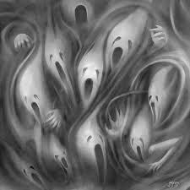
Fear no more the frown of the great, Thou art past the tyrant's stroke: Care no more to clothe and eat; To thee the reed is as the oak: The sceptre, learning, physic, must All follow this, and come to dust.

Slide 4
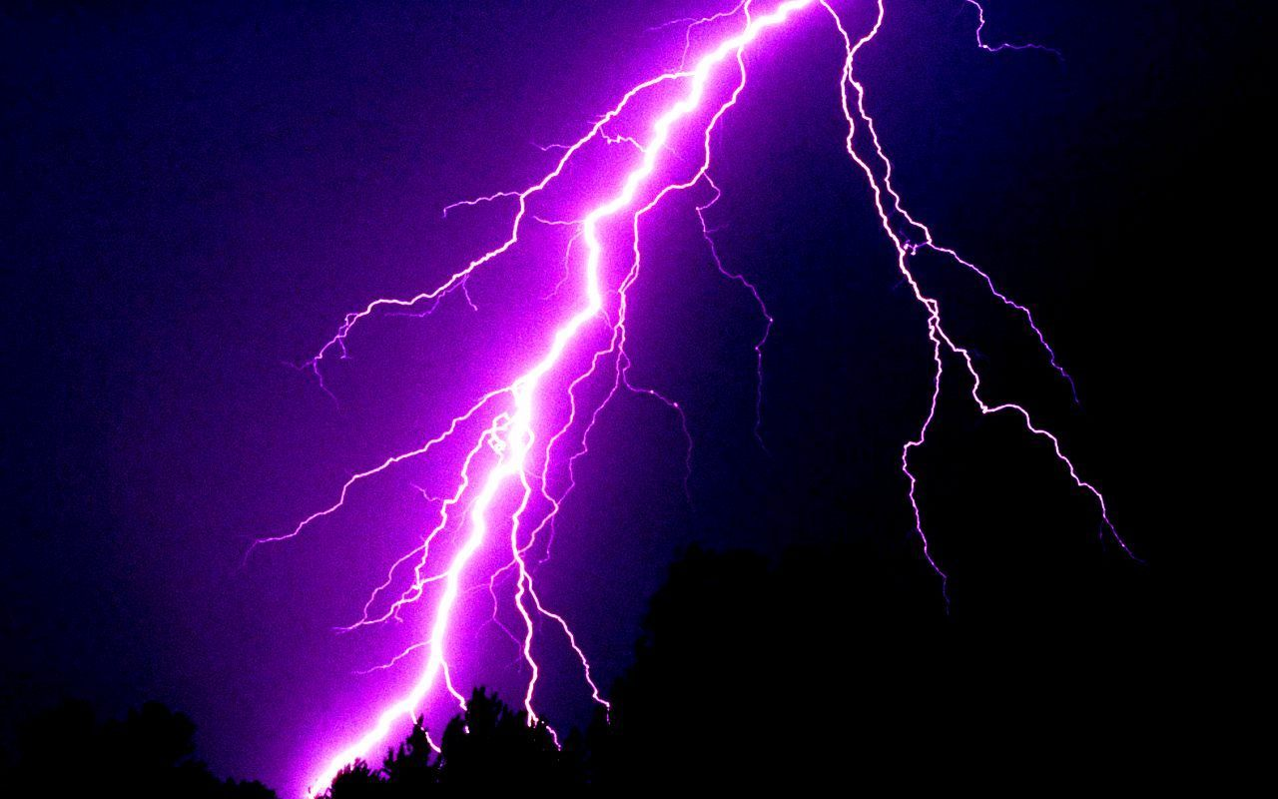
Fear no more the lightning-flash, Nor the all-dread thunder-stone; Fear not slander, censure rash; Thou hast finished joy and moan; All lovers young, all lovers must Consign to thee, and come to dust.

Slide 5
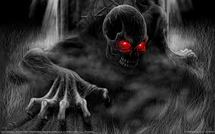
No exorciser harm thee! Nor no witchcraft charm thee! Ghost unlaid forbear thee! Nothing ill come near thee! Quiet consummation have; And renowned be thy grave!

