Slide 1
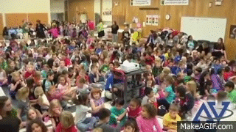
Is this your classroom?
Can you take another
second of it?

Slide 2
Then it’s time
to do this!

Slide 3
Want to know how?

Slide 4
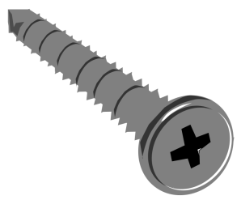
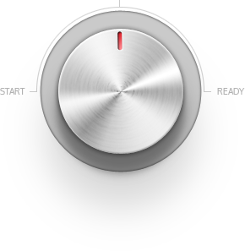
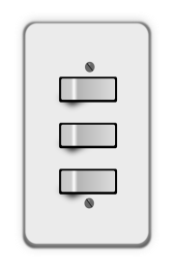
Well now you can!
With the brand new
MUTEMYSTUDENTS!

Slide 5
How does it work?

Slide 6
First, you turn the knob.
This turns the machine on.

Slide 7
The knob is a wheel & axle.

Slide 8
Next, you flip the switches.
The switches get set up based on the number of students.

Slide 9
All 3 switches are levers.

Slide 10
This causes the screw to spin the antenna.
This sends out a wave which eliminates the sound of yelling students.

Slide 11
This is a screw.

Slide 12
So next time you find yourself in this situation?

Slide 13
Go out and get…
MUTEMYSTUDENTS!

