Slide 1
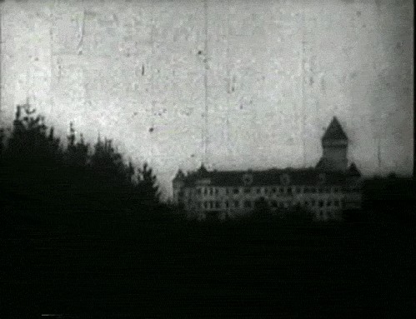

Twenty One Pilots
Doubt
Katherine Ruiz

Slide 2
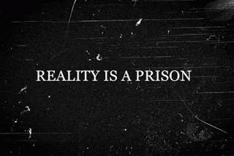

Slide 3
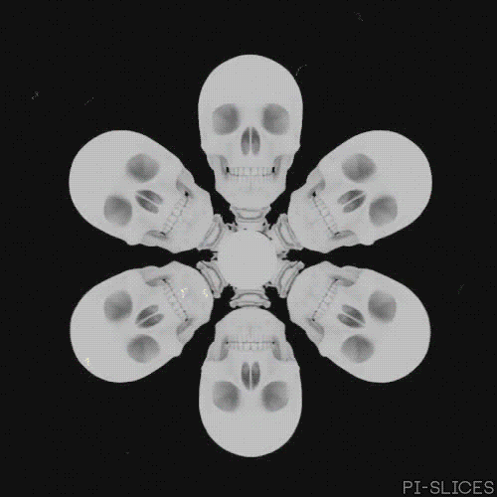
Scared of my own image,
Scared of my own immaturity
Scared of my own ceiling,
Scared I'll die of uncertainty,
Fear might be the death of me,
Fear leads to anxiety,
Don't know what's inside of me.

Slide 4
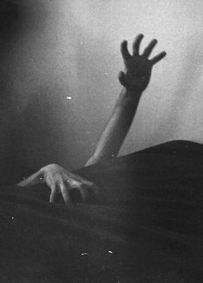
Don’t forget about me,
Don’t forget about me,
Even when I doubt you,
I’m no good without you, no ,no
2017/3/8

Slide 5


Slide 6
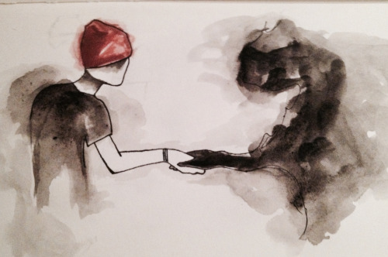
Temperature is dropping,
Temperature is dropping,
I’m not sure if I can see this ever stopping
Shaking hands with the dark parts of my thoughts
No
You are all that I’ve got
2017/3/8

Slide 7
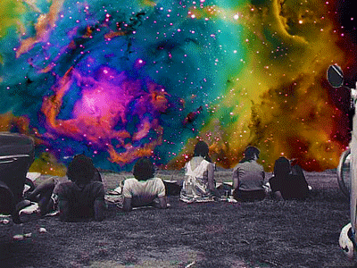
Don't forget about me,
Don't forget about me,
Even when I doubt you,
I'm no good without you, no, no, no, no, no
2017/3/8

Slide 8
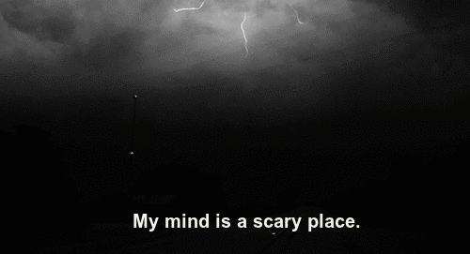

Slide 9
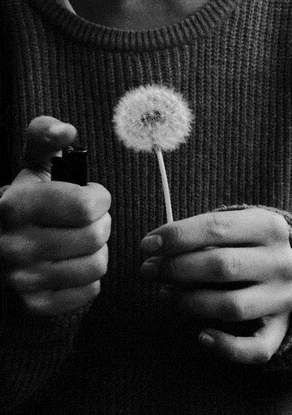
Gnawing on the bishops, claw our way up their system,
Repeating simple phrases, someone holy insisted,
I want the markings made on my skin,
To mean something to me again,
Hope you haven't left without me.
Hope you haven't left without me, please.
2017/3/8

Slide 10
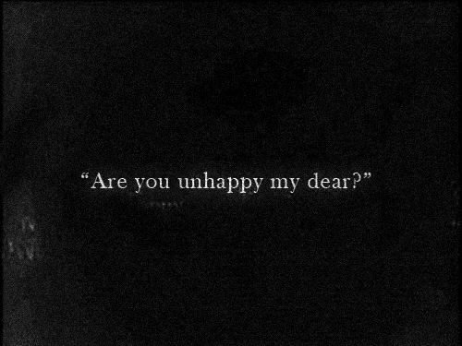

Slide 11


Slide 12

Don't forget about me,
Don't forget about me,
Even when I doubt you,
I'm no good without you, no
Don't forget about me,
Don't forget about me,
Even when I doubt you,
I'm no good without you, no, no, no, no
3/8/2017

Slide 13

Hey! Hey!
Don't forget about me, no
Hey! Hey!
Don't forget about me, no
Hey! Hey!
Don't forget about me, no
Hey! Hey!
Don't forget about me, no
3/8/2017

Slide 14
