Slide 1
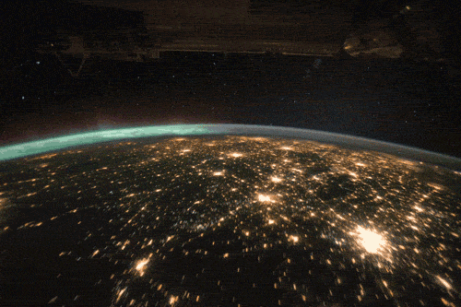
Great Night
Shafia Akey
6-407

Slide 2
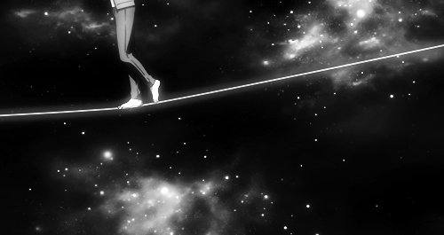
The night is a black panther
The moon has been eaten out of
The stars are frozen tears waiting for impact

Slide 3
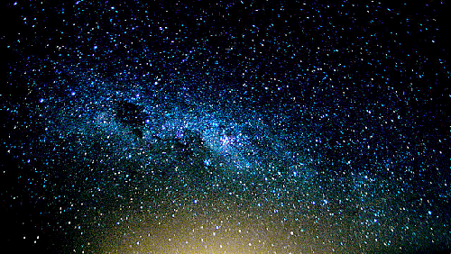
What a great and
mighty night
I hoot and hoot,
until morning rise

Slide 4
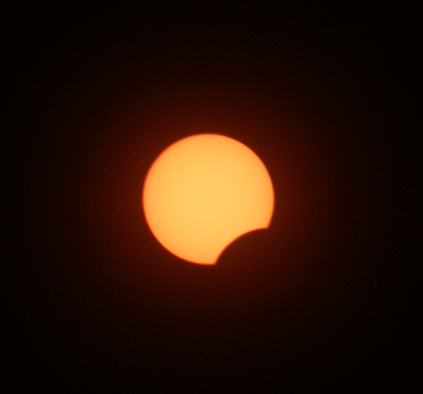
Again,as the moon plays peek a-boo
The world is listening to every noise and hoot that the night makes
I wonder how the world runs past through the danger

Slide 5
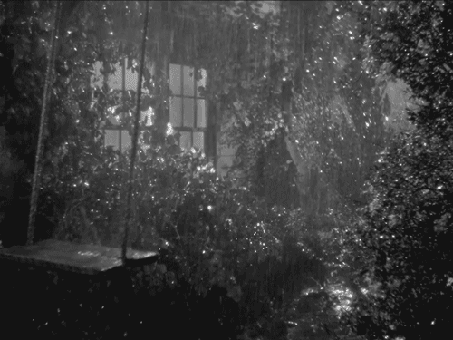
All of a sudden the world cries
What a great and mighty night
I chirp and chirp until morning rise

Slide 6
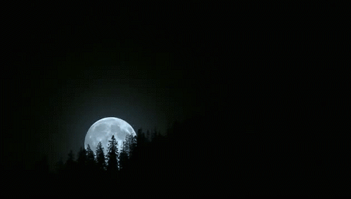
Tonight,the moon shows it’s face
Big and bright

Slide 7
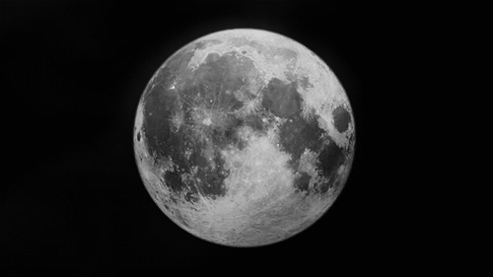
I grin at the moon while it grins back
The moon is my guardian angel for now

Slide 8
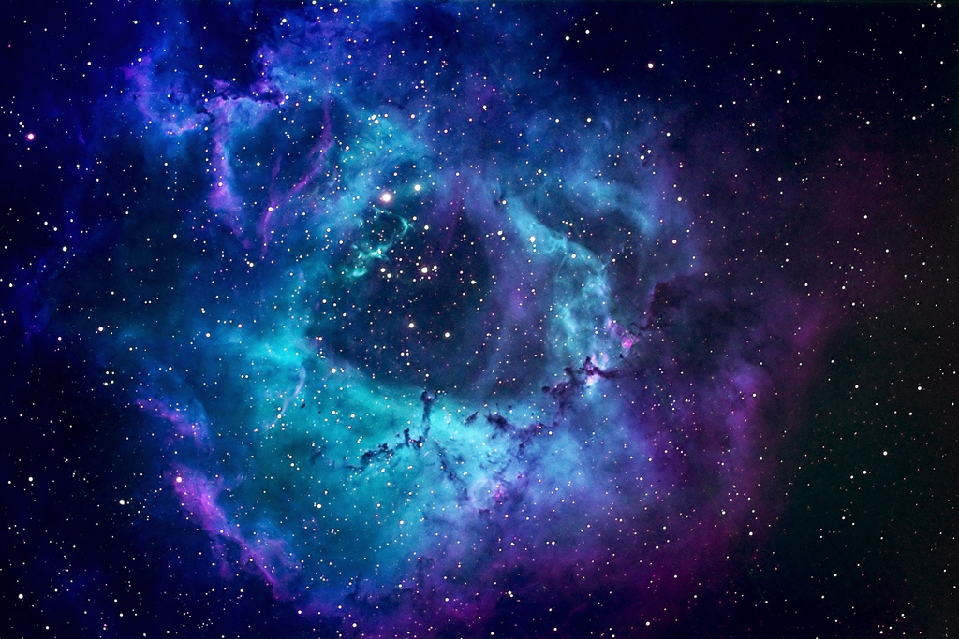
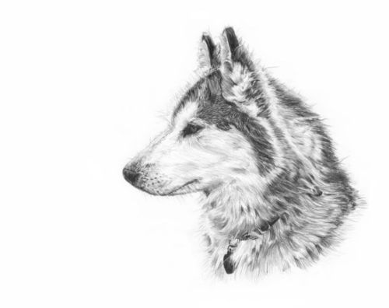
What a great and mighty night
I howl and howl,until morning rise

Slide 9
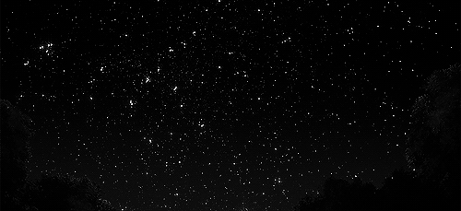
The night was black coal
The stars were beaming eyes

Slide 10
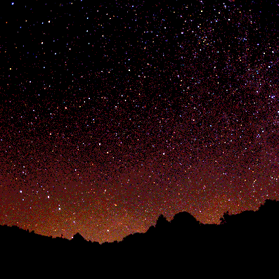
I waved at the night
The night cold kissed my cheek
What a great and might night
I roar and roar, until
Morning Rise

Slide 11
Alas’ tonight was the most prettiest of nights
But tonight my memory was
FOGGY

Slide 12
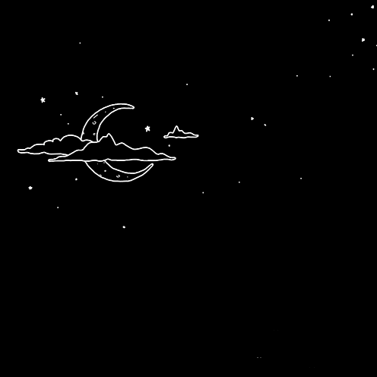
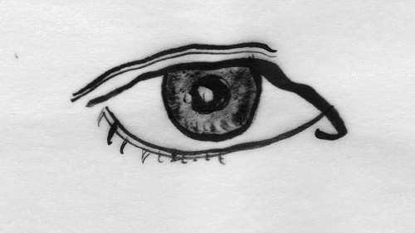
The night was light up my life
As,I closed my eyes

Slide 13
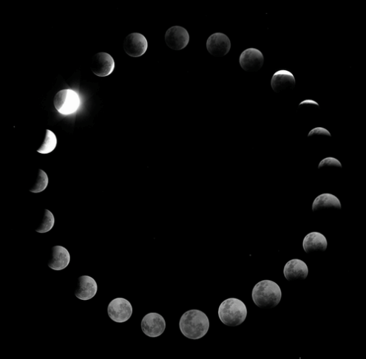
The night was then,frozen with sadness

