Slide 1
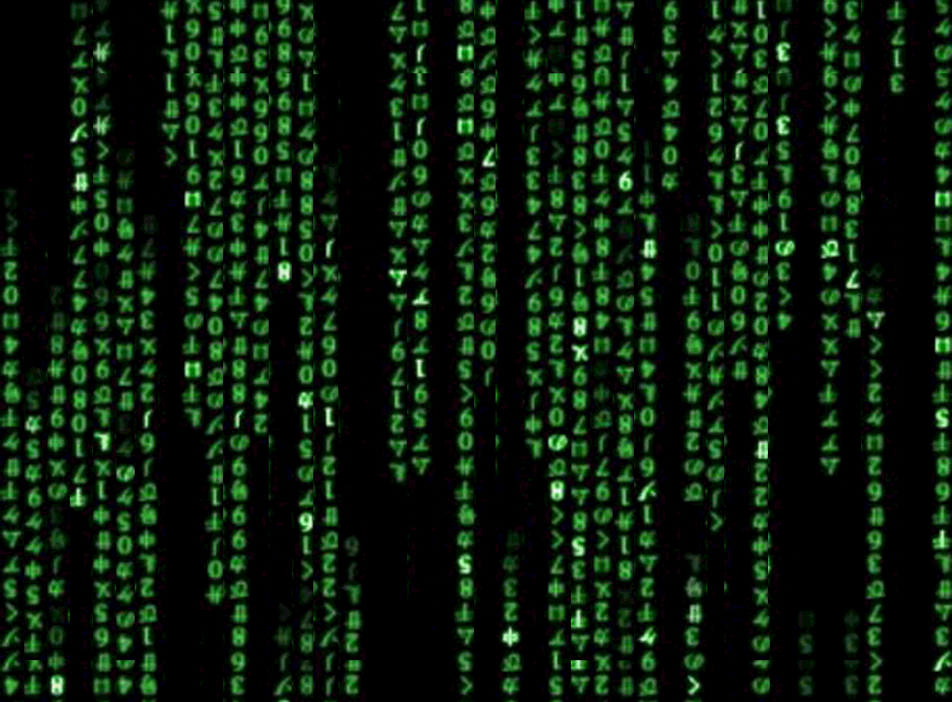
Coding Language

Slide 2
List of Terms:
Computer Science
Command
Function
Algorithm
Loop
Discuss with your group what you think the definition is. Do you have any examples?
TP – Students will decipher Coding Vocabulary with group discussion and modeling

Slide 3
List of Terms:
Computer Science
Command
Function
Algorithm
Loop
Now look it up. What definition or examples did you find?
TP – Students will decipher Coding Vocabulary with group discussion and modeling

Slide 4
Computer Science
Using the power of computers to solve problems.
TP – Students will decipher Coding Vocabulary with group discussion and modeling

Slide 6
Command
An instruction for the computer. Many commands put together make up algorithms and computer programs
TP – Students will decipher Coding Vocabulary with group discussion and modeling

Slide 7
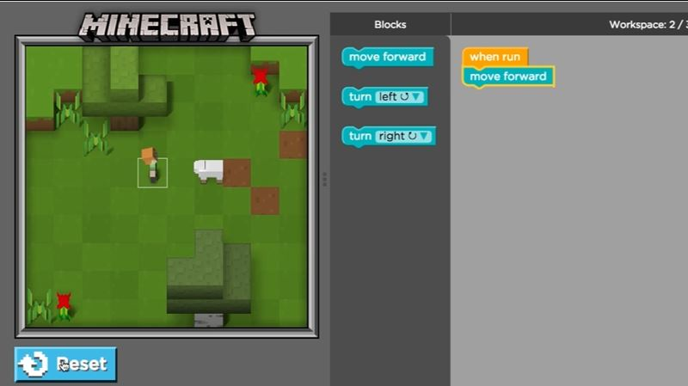

Slide 8
Algorithm
A list of steps to finish a task.
TP – Students will decipher Coding Vocabulary with group discussion and modeling

Slide 10
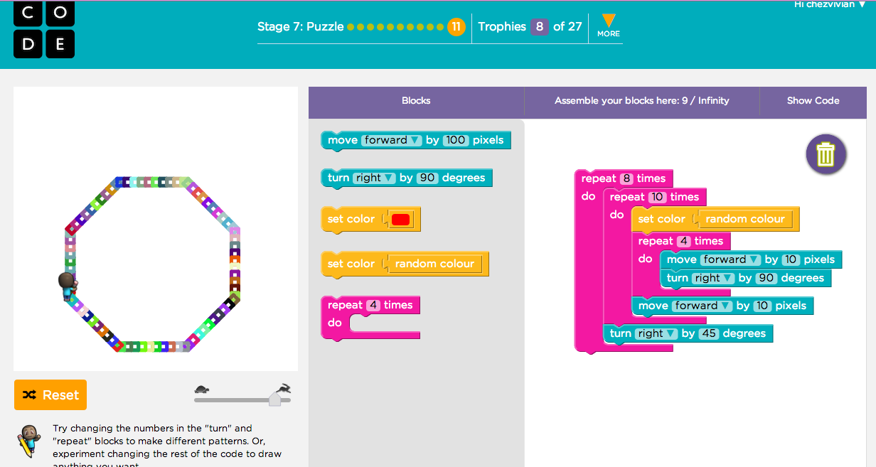

Slide 11
Function
A piece of code that you can easily call over and over again.
TP – Students will decipher Coding Vocabulary with group discussion and modeling

Slide 12
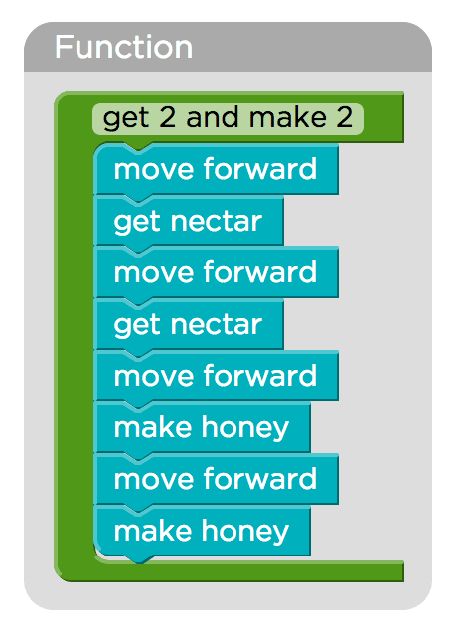

Slide 13
Loop
The action of doing something over and over again.
TP – Students will decipher Coding Vocabulary with group discussion and modeling

Slide 14
