Slide 1
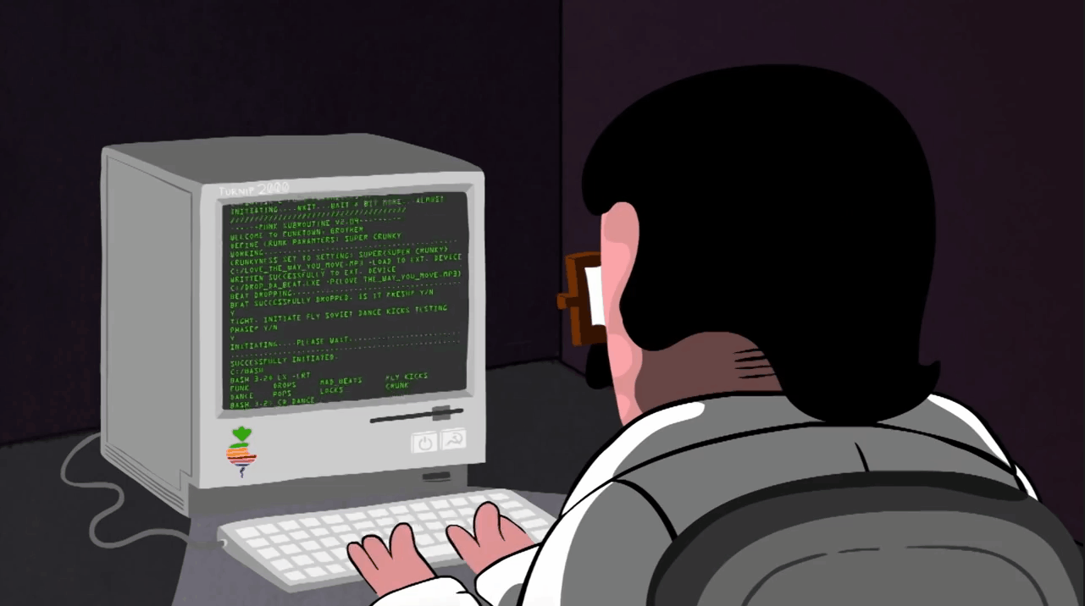
TP – Students will build critical thinking skills by learning programming concepts

Slide 3
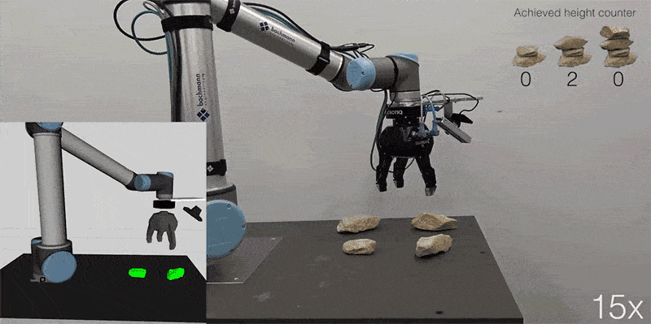
TP – Students will build critical thinking skills by learning programming concepts
How do you suppose that robots know how to do the things that they do? Do they have brains that work the same way that ours do?

Slide 4
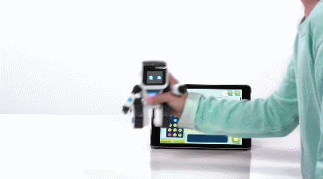
TP – Students will build critical thinking skills by learning programming concepts

Slide 5
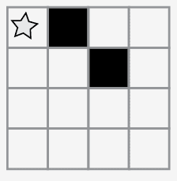
TP – Students will build critical thinking skills by learning programming concepts
Starting at the Star – How can we program to go to and fill in those boxes?
Turn and talk to your table and devise a method.

Slide 6
TP – Students will build critical thinking skills by learning programming concepts
Starting at the Star – How can we program to go to and fill in those boxes?
Turn and talk to your table and devise a method.

Slide 7
TP – Students will build critical thinking skills by learning programming concepts
What if we had a universal set of symbols such as this?

Slide 8
TP – Students will build critical thinking skills by learning programming concepts
Using these symbols, please write out the code for this:

Slide 9
TP – Students will build critical thinking skills by learning programming concepts
Using these symbols, please write out the code for this:

Slide 10
TP – Students will build critical thinking skills by learning programming concepts
On your Graph paper, please design your own pattern:

Slide 11
TP – Students will build critical thinking skills by learning programming concepts
As a team please decipher the pattern and code using the symbols we have learned:

Slide 12
TP – Students will build critical thinking skills by learning programming concepts
Things to think about:
What was today’s lesson about?
How did you feel during today’s lesson?
Draw another image that you could code. Can you write the program that goes with this drawing?
What other types of robots could we program if we changed what the arrows meant?

Slide 13
TP – Students will build critical thinking skills by learning programming concepts
Things to think about:
How did our paper graph program help prepare you?
Remember our vocabulary words….Did you use any of them?
What did you learn?
What, if anything, did you find more challenging?

