Slide 1
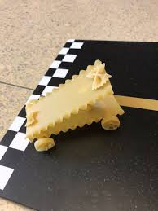
TP – Students will explore energy and variables by designing car from various pastas
Your goal is to design the vehicle that will go the furthest when released down a ramp.

Slide 2
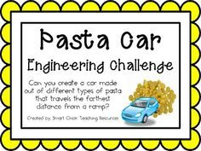
TP – Students will explore energy and variables by designing car from various pastas

Slide 3
TP – Students will explore energy and variables by designing a car from various pastas
Materials:
2 Lasagna noodles
Assortment of different pasta noodles
Glue
Tape

Slide 4
TP – Students will explore energy and variables by designing a car from various pastas
Question:
What energy factors play a role in how far the vehicle travels?

Slide 5
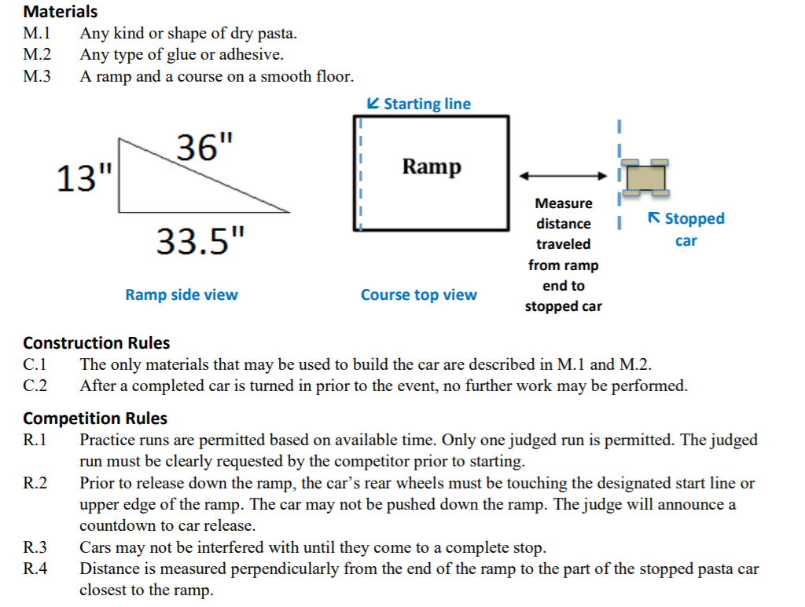
TP – Students will explore energy and variables by designing a car from various pastas

Slide 6
TP – Students will explore energy and variables by designing a car from various pastas
Break into groups of 2-4
You are going to start your planning process – how will it look? Why?
Include notes, drawings, sketches, etc.

Slide 7
TP – Students will explore energy and variables by designing a car from various pastas
While you are planning, please document with pictures, video, sketches, etc.
Start to create your slideshow or movie – title, group members, introduction, and initial design

Slide 8
TP – Students will explore energy and variables by designing a car from various pastas
Project Time:
You will now be asked to get to work on the Technology side of the lesson. You will be asked to take Your pictures/videos and create a presentation. The presentation must include:
The team members names
The initial design – Why did you make that design?
The process – How did you go about the construction?
The problems – What issues did they run into? The final vehicle – What were it’s strengths and weaknesses?
Comments on the other vehicles – What would you do the same or change?

